Slide 1
Manual Testing

Slide 2
Overview software testing
Process of identifying errors, gaps or missing requirements
Benefits:
Cost-Effective
Security
Product Quality
Customer Satisfaction

Slide 3
Types of software testing
Software Testing
Manual
Functional
Non Functional
Automation
Maintenance Testing

Slide 4
Functional testing
Unit Testing
Testing individual units of Components
Smoke Testing
Build verification test/Build Acceptance test
Testers doing Smoke testing after deployment
Integration testing
Testing interfaces between Modules
System Testing
User Acceptance Testing
Developers doing unit testing
Testing the complete and fully integrated module
End user Acceptance testing
Usually done before production

Slide 5
Non Functional testing
Performance Testing
Testing process used to test speed and performance
Load Testing
Performance of software application is tested under a specific expected load
Security Testing
Testing that uncovers vulnerabilities of the system
Compatibility Testing
Accessibility Testing
capable of running on different environment
Process of Verifying application that can be used by persons with disabilities

Slide 6
Maintenance testing
Regression Testing
Process of verification of an application to confirm recent code changes are not affecting existing features.

Slide 7
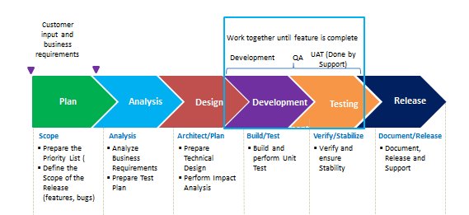
Software development lifecycle (SDLC)

Slide 8
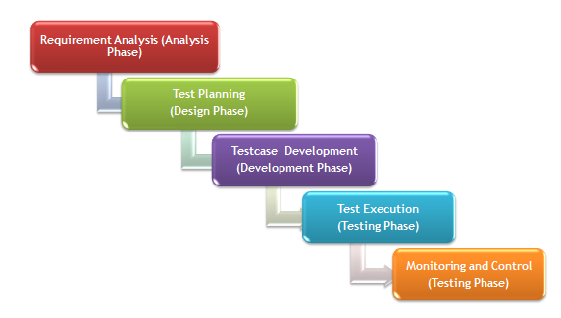
Software testing life cycle (STLC)

Slide 9
Requirement Analysis
Activities :
Study and Understand the requirement
Prepare Queries and Interact with various Stakeholders (Product Manager, Development Lead / Architect etc.) to understand the requirement
Impact Analysis and Identify types of testing
Automation feasibility Analysis
Prepare Requirement Traceability
Identify Risks
Entry Criteria: Release plan Requirement Document (SRS Document) iTrack Description | Exit Criteria: Requirement Analysis Document Test plan Draft

Slide 10
Test Planning
Activities :
Define Objective and Scope
Create Test Plan and Define testing Strategy
Detailed effort estimation and Resource Plan Creation
Define Testing Process and Test Environment
Prepare QA Schedules and Define UAT Delivery date
Define Risks and Mitigation Plan
Review and approve Testplan
Entry Criteria: Release plan Requirement Document Requirement Analysis Document iTrack Descriptiont Test plan finalized | Exit Criteria: Approved Test Plan Effort Estimation Resource Plan QA Schedules and UAT Delivery date Test cases Draft

Slide 11
Testcase Development
Activities :
Create, Review and approve testcases.
Setup test Environment and Prepare Test Data
Map Testcases id to Requirement id in iTrack to maintain Requirement Traceability.
Entry Criteria: Requirement Analysis Document Approved Test plan Document Requirement Traceability Matrix | Exit Criteria: Approved Test Cases Review Feedback List Test Environment with Test Data Updated Requirement Traceability Matrix

Slide 12
Test Execution
Activities :
Execute Testcase and Identify Bugs
Document & Maintain Test Results and Create Defect for failed cases
Map Defect id to Requirement/Enhancement id in iTrack to maintain requirement Traceability.
Retest the defects after fix
Create Test Summary Report and Bugs Report
Create and Review Automation Scripts
Entry Criteria: Requirement Analysis Document Test plan Document Requirement Traceability Testcases | Exit Criteria: Test Results Test Summary Report Bug Report Updated Requirement Traceability. 5. Create Automation Script

